Slide 1
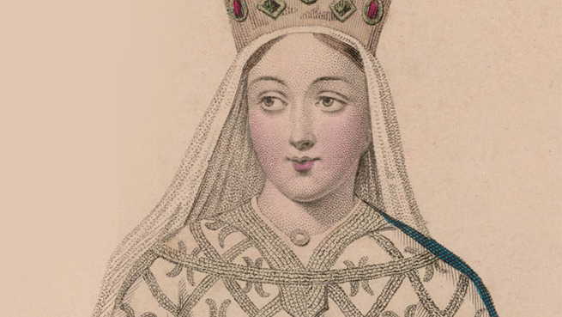
Eleanor of Aquitaine: The Queen with Two Crowns
Brady Grove
230148155
HIST 312
Dr. Lightfoot

Slide 2
Today we will be covering…
Early life of Eleanor of Aquitaine
Her marriage and divorce to Louis VII
Her marriage and divorce to Henry II
The role she played in the rebellion against Henry II with her sons

Slide 3
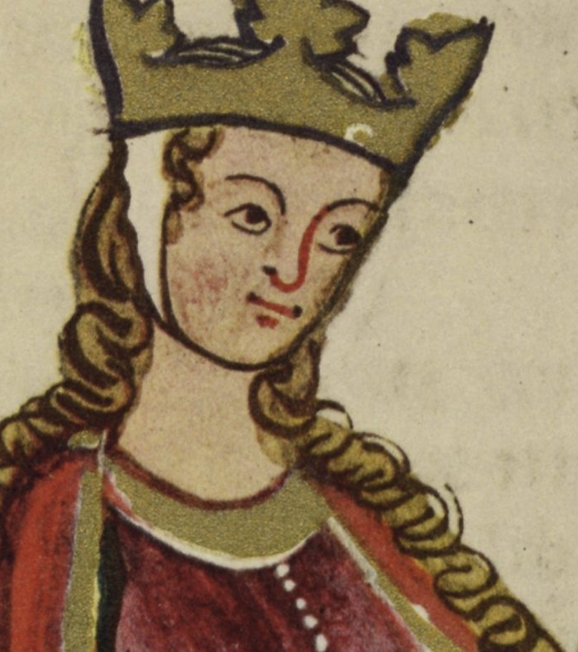
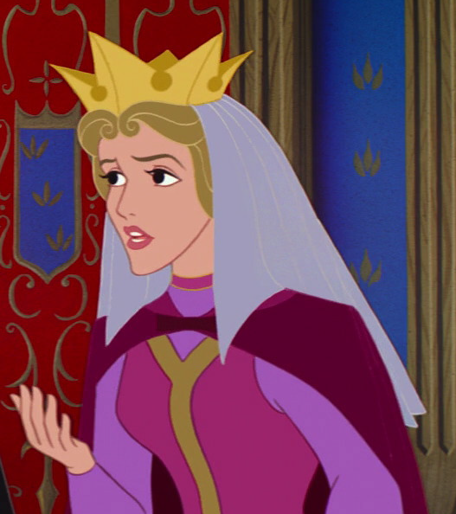
what does A QUEEN look like TO YOU?
Before we begin..

Slide 4
Early Life of Eleanor
Born in 1112- Died in 1204
Before the age of seven she attained a degree in sophistication appropriate for her rank
Eleanor grew up spoiled as a child
Had always been independent, defiant, and a tomboy
She believed she didn’t need man and that she could take her life into her own hands
“brought up in delicacy and reared with abundance of all delights of wealth” (Richard le Poiteuin 1170’s)
Educated and grew up to be very energetic, and a talented sportswoman
Rode horses at an early age and took part in hawking
At 15 Eleanor was now Countess to Poitou and Duchess of Aquitaine

Slide 5
Queen of France
Married in 1137
Eleanor was not in love with Louis VII
The marriage itself was a political circumstance following the death of her father
Eleanor had reservations about the marriage
She believed Louis ranked beneath her
She had a small amount of respect for him.
They annulled their marriage in March 1152
-

Slide 6
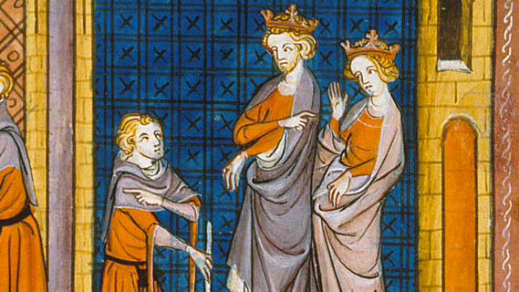
Marriage to Henry ii
One of the most chaotic
Henry and Eleanor met secretly in Paris and agreed to marry once her first marriage had been annulled.
Remarried in May 1152 quietly without a ceremony
Both strong, dynamic, characters with forceful personalities
Caused a lot of hatred between Henry II and King Louis VII after she failed to get consent from him to remarry

Slide 7
Role in the Rebellion Against Henry II
Henry divides up his kingdom among his sons but gives them no real power to rule.
Eliminates most of Eleanor’s power as Queen
Eleanor’s son’s rebel against their father in 1137 and she aides them.
During the rebellion Eleanor maintained her independent court in Poitou in the interest of her sons.
Deployed emotions in her letters strategically to gain support from other political leaders (Kings, Dukes)
Used her emotions to reinforce her position of authority
Never allowed herself to become a victim even after being imprisoned by Henry II

Slide 8
Activity for Today...
Eleanor of Aquitaine
Disney Queen

Slide 9
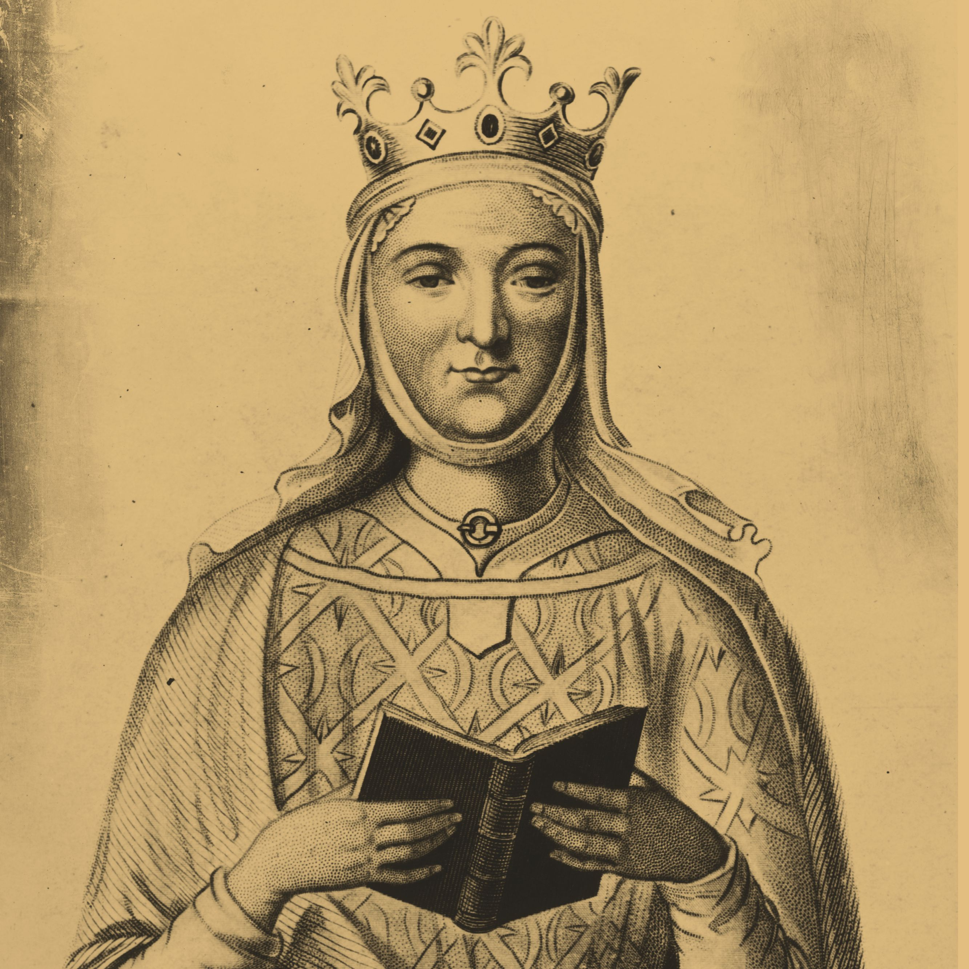
Wrap up and review
You are now an expert historian on Eleanor of Aquitaine! what was one thing you found the most interesting about her? Can you think of any other real-life queens?

Slide 10
Works Cited
Eleanor of Aquitaine Drawing. https://www.englishmonarchs.co.uk/plantagenet_19.htm
Eleanor of Aquitaine Drawing. https://www.onthisday.com/people/eleanor-of-aquitaine
Eleanor of Aquitaine Drawing. https://britishheritage.com/history/history-eleanor-aquitaine
Eleanor of Aquitaine Queen Consort of England. https://www.alamy.com/stock-photo-eleanor-of-aquitaine-1122-1204-was-queen-consort-of-england-from-11541189-171291130.html
Eleanor of Aquitaine Marrying King Louis VII. https://rebeccastarrbrown.com/2018/08/01/when-eleanor-of-aquitaine-as-queen-of-france/
Eleanor of Aquitaine Marrying Henry II. https://rebeccastarrbrown.com/2018/03/27/the-early-years-of-henry-ii-eleanor-of-aquitaine/
Eleanor Riding with her favourite son Richard Lionheart. https://www.grunge.com/368986/how-eleanor-of-aquitaine-became-one-of-the-most-powerful-women-in-history/
Queen Leah from Disney’s Sleeping Beauty. https://disney.fandom.com/wiki/Queen_Leah
Epistolae. Medieval Women’s Latin Letters. Eleanor of Aquitaine. https://epistolae.ctl.columbia.edu/woman/24.html
UXL Biographies. (2011). Eleanor of Aquitaine. Retrieved from: link.gale.com/apps/doc/EJ2108100714/CIC?u=unorthbc&sid=summon&xid=b9d6028c.
Kelly, A. (1937). Eleanor of Aquitaine and Her Courts of Love. Speculum, 12(1), 3–19.
https://doi.org/10.2307/2848658
Meade, M. (1991). Eleanor of Aquitaine A Bibliography. Penguin Books USA Inc
Mitchell, L. (2018). “Give Me Back My Son!” Eleanor of Aquitaine, Emotion Talk, and
the Gendering of Political Rhetoric. Retrieved from: https://go-gale-
com.prxy.lib.unbc.ca/ps/i.do?p=AONE&u=unorthbc&id=GALE|A568839534&v=2.1&it
=r&sid=summon

