Slide 1
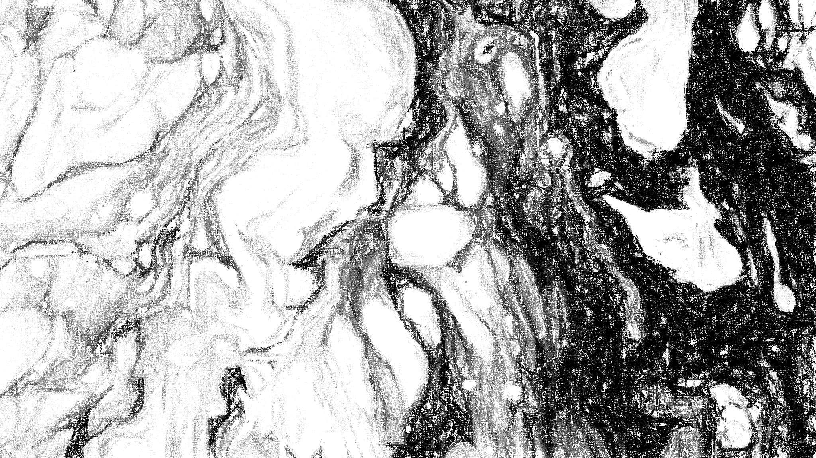
An Ambiguity: The Criminality of Prostitution in Late 14th Century London, England
Click this button for audio on every slide.
By Kaylie Boersma
History 312
Dr. Dana Wessell Lightfoot

Slide 2
What comes to mind when you think of prostitution?
Part 1
Part 2
Sex
Choice
Women
Brothels
Criminals

Slide 3
Objectives
To establish the complexities of prostitution based on the treatment of sex workers and attitudes towards the idea of prostitution.
To highlight how prostitution represents an ambiguity in which prostitution was both legal and illegal.
To emphasize sex workers as victims and agents within the institution of prostitution.
To demonstrate how sex workers were demoralized and taken advantage of even when they were needed to provide a service.

Slide 4
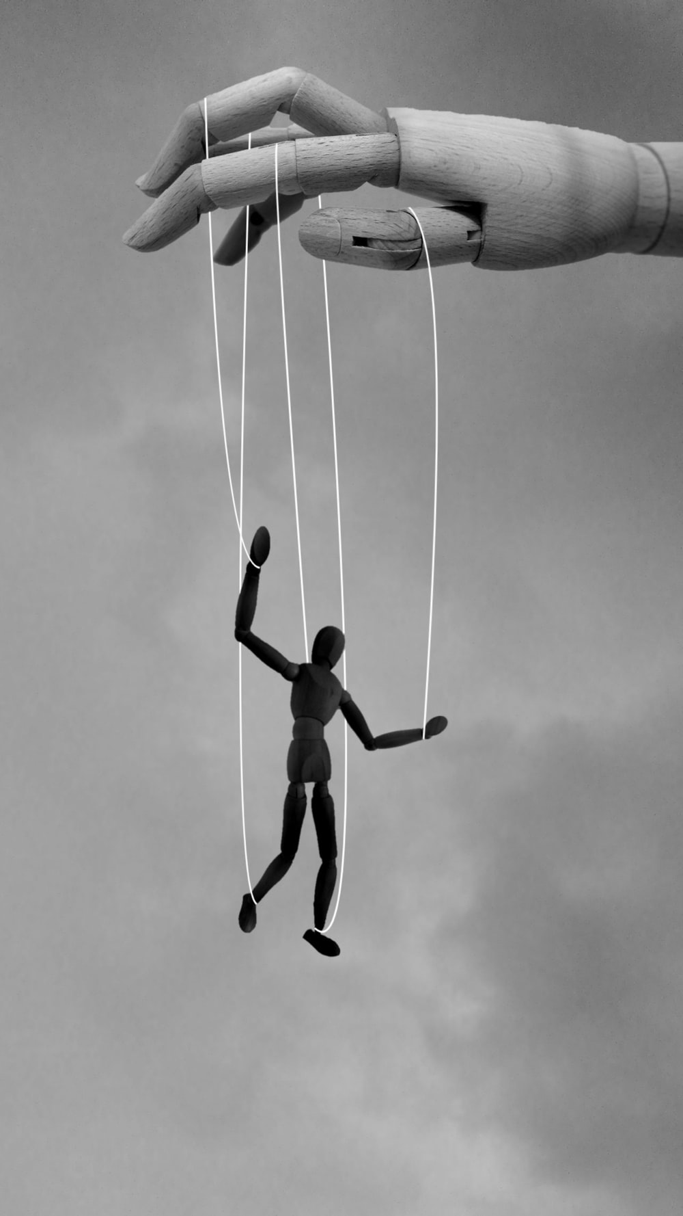
What is Patriarchy?
Patriarchy is a concept that involves a power dynamic in which a small group of men have control over some men and all women.
It involves the ideology that men are dominant and superior, whereas women are inferior and subordinate to men.
Silvani B, “Once you Hand Them the Strings, They Become the Narrator of Your Life.” – Unknown, photograph, Unsplash, June 20, 2021, https://unsplash.com/photos/bczrpU9n8f4.

Slide 5
Why Prostitution?
Jobs available to women were limited and women were underpaid (”Common Women” 50).
Many women chose prostitution out of choice, with some external forces influencing their decision such as lack of work opportunities (“Common Women” 48).
Most women chose prostitution out of necessity to gather enough money to support themselves on occasion (Goldberg 185).
Some women were forced, unwillingly and unknowingly.

Slide 6
Single Women, Common Women, and Sex Workers
“Prostitutes represented something that men distrusted in all women. A prostitute was someone who brought her sexuality out of the private into the public realm” (”Sex, Money, and Prostitution” 211).
The ideal set out in the London ordinances, as Cordelia Beattie argues, is an ideal based on having single women as the only prostitutes (Beattie 201).
“A ‘common woman’ in medieval England was one who had many sex partners, often for money” (”Common Women” 3).

Slide 7
The Law
“Law does not emerge on its own; society creates it, and law reflects that society’s needs, assumptions, and mores … Regulation [of prostitution] was aimed not at abolishing commercial prostitution, but at keeping it accessible while keeping its practitioners in their place” (“Common Women” 13-14).

Slide 8
Separation of “Good” and “Bad”
“Concerns that the ‘reputable’ would be ‘corrupted’ are expressed in … London records” (Beattie 206).
“The prostitute was formally accepted as the receptable of a society’s filth, a necessary, if odious, evil” (Mummey 165).
The push to remove pigs from urban environments due to their uncleanliness is correlated to the removal of sex workers from city limits as both pigs and sex workers represent lust, movement around the city, and a “threat to the moral order” (Goldberg 172-173).
A distinction was made between moral women and immoral sex workers both in identifiable characteristics and the push to have two separate spheres to distinguish these groups of women.

Slide 9
Clothing: A Required Distinction
Sex workers are wearing clothes that disguise them as women of morals and that is inappropriate for their nature (“Proclamations” 267).
“If any common woman wears an apron, she shall forfeit it, and make a fine” (”Text of Ordinances” B28).
No woman of immoral nature should wear fur or any clothing that would signify nobility (“Proclamations” 267).

Slide 10
Treated as Criminals
Any women engaging in lewd acts such as hiding her status as a sex worker from the Bishop of Winchester’s Liberty, housing sex workers in a brothel, or is caught wandering in London, or is found inside Southwark after curfew could face steep fines (“Text of Ordinances” B5, B10, B16).
Elizabeth Moring was an infamous criminal procuress.

Slide 11
“The medieval authorities considered prostitutes both subject and object, agent and victim. In general, prostitutes were blamed for their actions, which they were believed to commit out of lust (even if they were financially needed as well); but when a brothelkeeper or procurer was prosecuted, the prostitutes could be treated as innocent pawns” (“Common Women” 48).

Slide 12
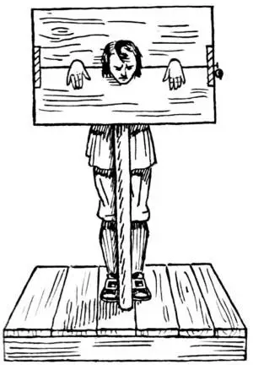
Procuring and the Pillory
Elizabeth Moring was a woman accused and found guilty of procuring women under the false pretense of working as an embroiderer and then forcing these women to become sex workers.
Those in attendance to her trial were men, such as the mayor, sheriffs, the jury, and the alderman (“Illegal Prostitution” 255, 257).
“Through such women and the like deeds many scandals had befallen the said city, and great peril might through such transactions in future arise therefore, according to the custom of the city of London in such and the like cases provided, and in order that other women might beware of doing the like,” Elizabeth was chosen to be publicly humiliated through the public punishment of being placed in a pillory (“Illegal Prostitution” 257).
Johanna, the woman who provided a victim statement, and the unnamed male client do not appear to have been charged for any crime.
The Treehouse, photograph, Tes, February 27, 2020, https://www.tes.com/teaching-resource/medieval-crime-and-punishment-11393228?theme=4.

Slide 13
Prostitution: A Double-Edged Sword
Positive
Negative

Slide 14
“Each day medieval societies made choices that put prostitutes in an intriguing gray area where they were both marginal and central, persecuted and accepted” (Mummey 166).

Slide 15
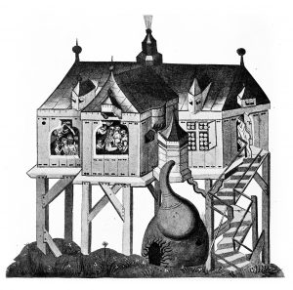
Southwark Stews
Southwark: A suburb in London, England with brothels known to locals as the stews (Beattie 200).
“We do by our command forbid … that [any woman accused of prostitution] shall go about or lodge in [London], or in the suburbs thereof, by night or by day; but they are to keep themselves to the places thereunto assigned, that is to say, the Stews” (“Street Walkers” 535).
Kate Lister, A 15th-Century Bathhouse, photograph, Brewminate: A Bold Blend of News and Ideas, November 23, 2018, https://brewminate.com/wp-content/uploads/2018/11/111018-64-History-Medieval-Middle-Ages-Prostitution-Religion.jpg.

Slide 16
Southwark Stews
The brothels were established to “maintain social order,” not to keep prostitutes safe (”Common Women” 32).
Financial opportunities led to the regulation of brothels (“Common Women” 33).
By making sure that brothelkeepers are regulated meant that not only is their power over sex workers limited, but those in charge of regulating and enforcing punishments towards prostitution were able to grow their own power (“Regulation of Brothels” 424).

Slide 17
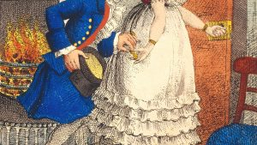
A Profitable Business
The Bishop of Winchester’s Liberty controlled the brothels located in Southwark, despite the church being against prostitution (Beattie 204; ”Regulation of Brothels” 423).
Large demand for sex from clergy members (Goldberg 175-176).
By legalizing brothels in Southwark, the Bishop of Winchester was able to have full control of the brothels in this region, thereby maximizing profits (“Regulation of Brothels” 424).
Kate Lister, In 14th-Century London, Church Leaders Discovered How to Make a Tidy Income From Sex Workers, photograph, Brewminate: A Bold Blend of News and Ideas, November 23, 2018, https://brewminate.com/wp-content/uploads/2018/11/111018-63-History-Medieval-Middle-Ages-Prostitution-Religion.jpg.

Slide 18
Conclusion
Sex workers in medieval London were treated unfairly, while simultaneously being appreciated for their services to please the lustful nature of men.
On one hand, church officials, the mayor, and alderman of London wanted to regulate prostitute as is evident through the use of court documents and the London ordinances, but at the same time these officials were also clients of sex workers and in the case of the Southwark stews, the Bishop of Winchester profited off prostitution.
Prostitution was an ambiguity.

Slide 19
Check Your Understanding
Part 1
What are your thoughts about prostitution now?
Have any of your previous beliefs changed, or stayed the same?
What do you think of women’s status in medieval society?
Part 2

